Slide 1
PRESENTATION
ON
CUSTOMER RETENTION
Submitted to: Submitted by:
Flip Robo Technologies Priya Rajput

Slide 2
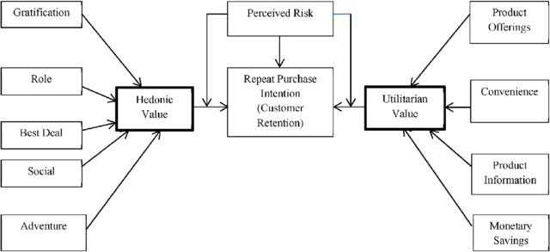

Slide 3
INTRODUCTION
Business Problem Framing
Conceptual Background Of Domain Knowledge
Problem Statement
ANALYTICAL PROBLEM FRAMING
EXPLORATORY DATA ANALYSIS
CONCLUSION WITH FUTURE SCOPE

Slide 4
CUSTOMER RETENTION
Customer retention is the collection of activities a business uses to increase the number of repeat customers and to increase the profitability of each existing customer.
Customer retention indicates customer’s intention to repurchase a service or a product from the service provider.
Five major factors that contributed to the success of an e-commerce store have been identified as: service quality, system quality, information quality, trust and net benefit.

Slide 5

The objective is to keep finding a way to hold customer back, make them trust the brand and keep and produce valuable insights help in customer retention

Slide 6
CONCEPTUAL BACKGROUND OF THE DOMAIN PROBLEM
Consumer demands retailers are constantly reshaping their business strategies and striving to offer the right products and services both to meet existing needs and to anticipate and stimulate future demand.
Five major factors that contributed to the success of an e-commerce store have been identified as: service quality, system quality, information quality, trust and net benefit.

Slide 7
Problem Statement
The combination of both utilitarian value and hedonistic values are needed to affect the repeat purchase intention (loyalty) positively .
The objective was to perform extensive data analysis on a given dataset and produce valuable insights that will help in customer retention.

Slide 8
import numpy as np
import pandas as pd
import matplotlib.pyplot as plt
import seaborn as sns

Slide 9
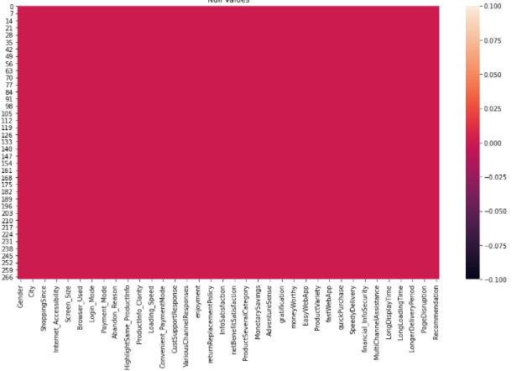
Null values
There is no null values in the dataset

Slide 10

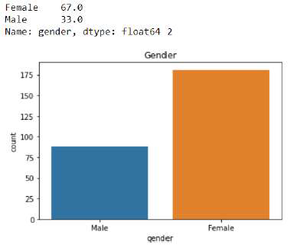
Feature: Gender
Observation: Female count is double than male in online shopping

Slide 11

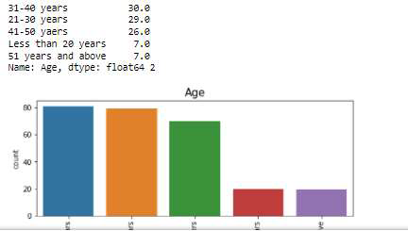
Feature: Age
Observation: Higher number i.e 30% of online shopping is done by the age group of 31-40 years.

Slide 12

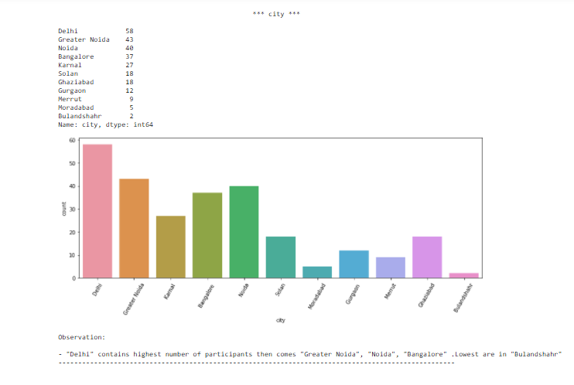
Feature: City
Observation: Delhi has maximum percent (22%) which show that in Delhi the online purchase is high
as compared to other.

Slide 13
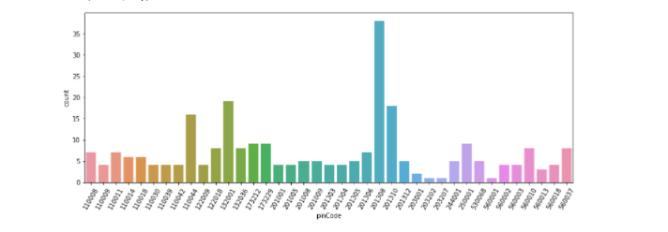
Pincodes
Feature: Age
Observation: A city with pin code 201308(Delhi) has maximum online shopping

Slide 14
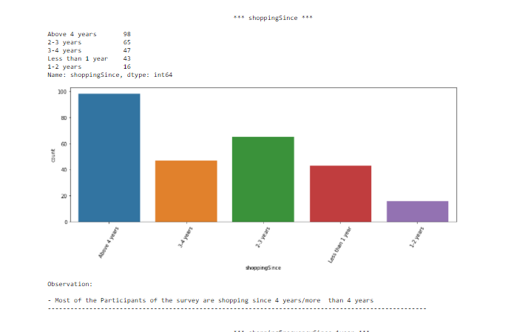
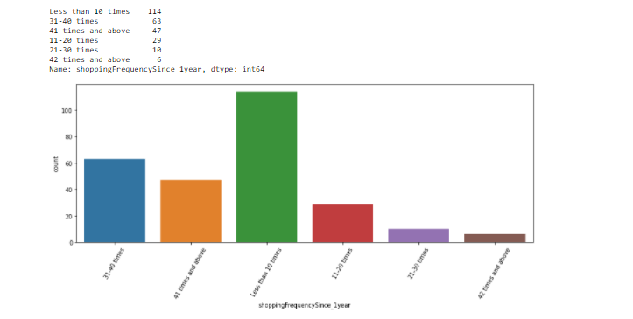
Customer distribution since how many years they are shopping and their shopping frequency

Slide 15
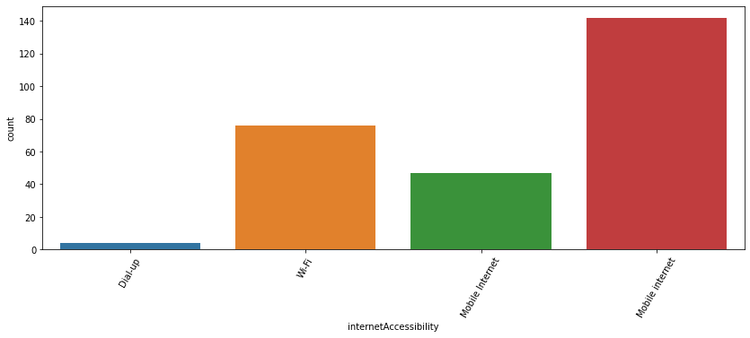
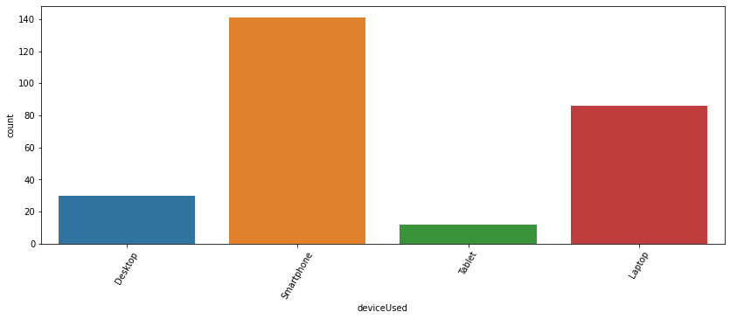
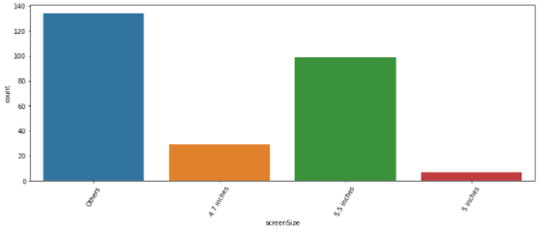
Internet Accessibility
Maximum customers use their Mobile internet for online shopping.
Device Used
Large number of participants use their Smartphone to shop online.
Screen Size
Participants use their 5.5 inches of screen size to shop online largely, and here we can see that in our dataset contains most of
the participants use any other screen size

Slide 16
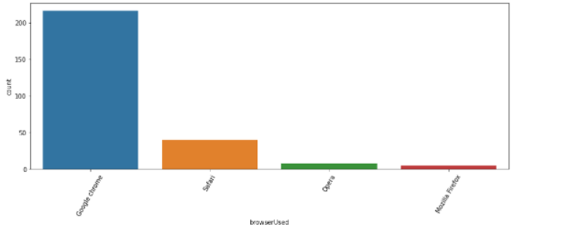
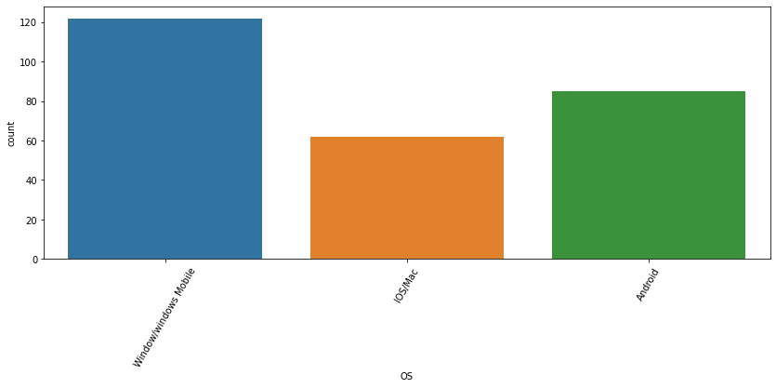
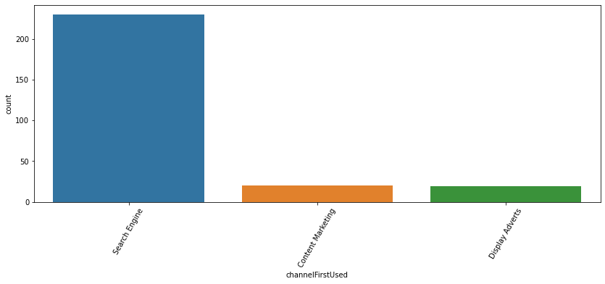
Operating System: Majority uses Window/windows Mobile to shop online then, "Android" then, comes IOS/Mac.
Browser : Google Chrome browser are widely used for online website access when compared to other browser.
Channel First: Search Engine were widely used to follow to arrive at their favourite online store for the first time.

Slide 17
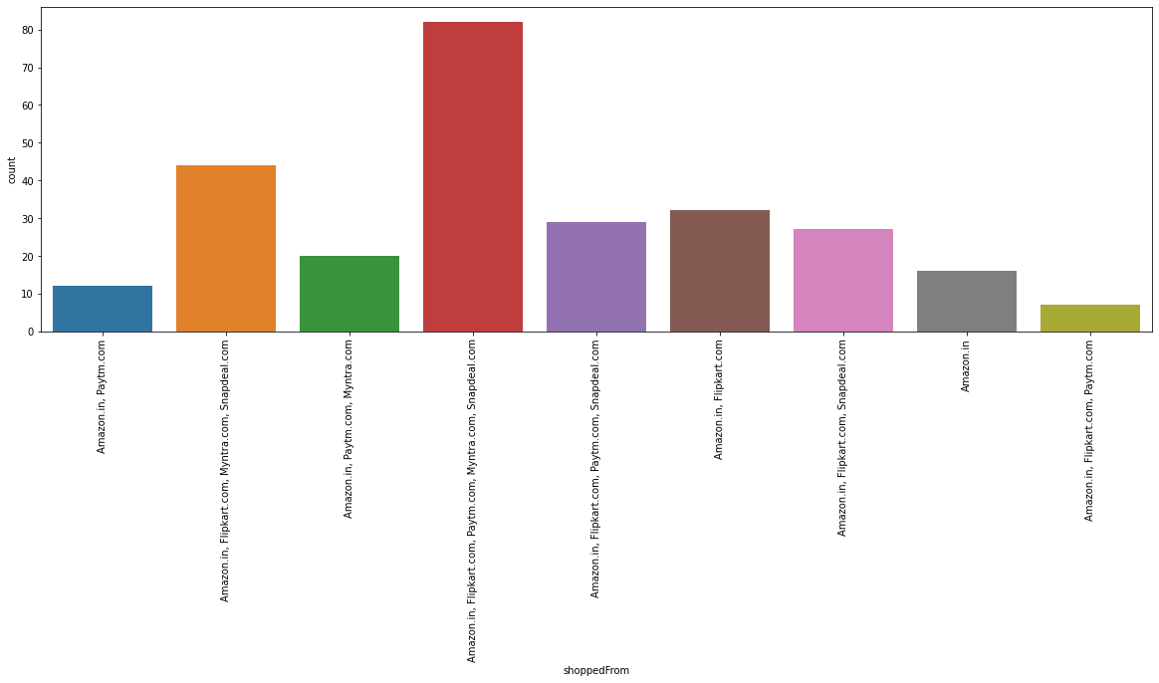
Shopping Retailers
Most Participants have shopped from these 5 companies :"Amazon.in, Flipkart.com, Paytm.com, Myntra.com, Snapdeal.com".

Slide 18

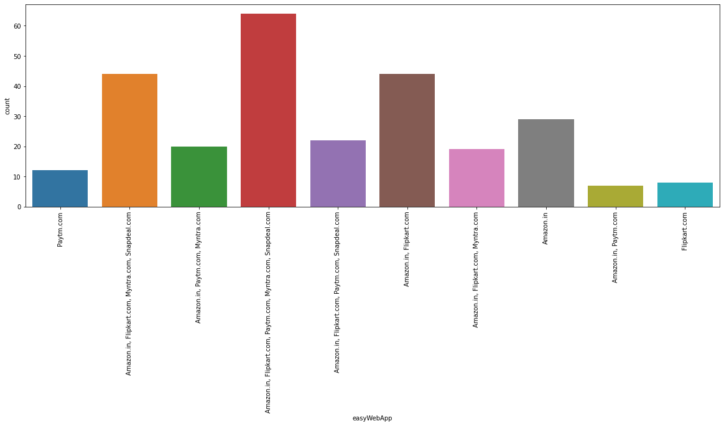
people choose all retailers for easy to use websites

Slide 19
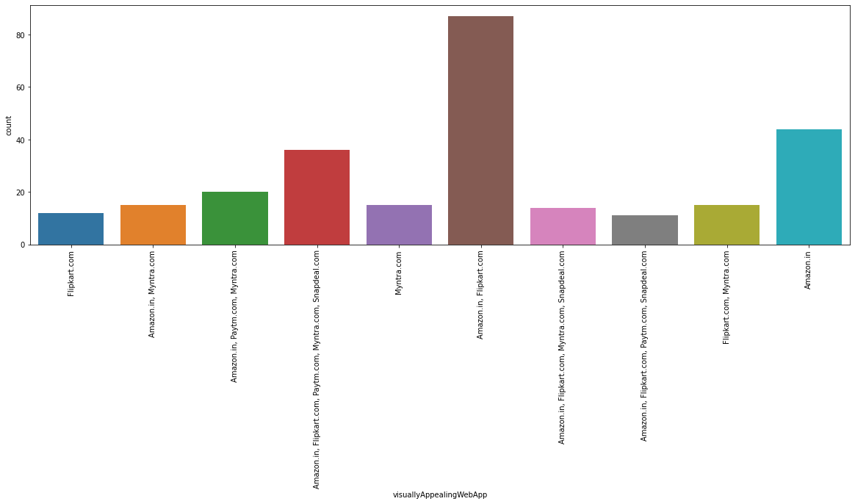
Visual Appealing Web Application
Amazon.com and Flipkart.com has a good "Visual appeal web-page layout' as per the survey

Slide 20
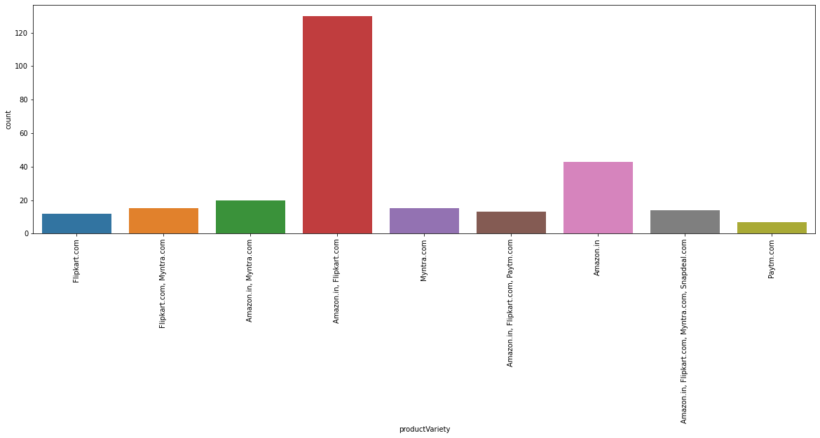
Product Variety
Wide variety of product on offer are mostly obtained in Amazon.com and Flipkart.com

Slide 21
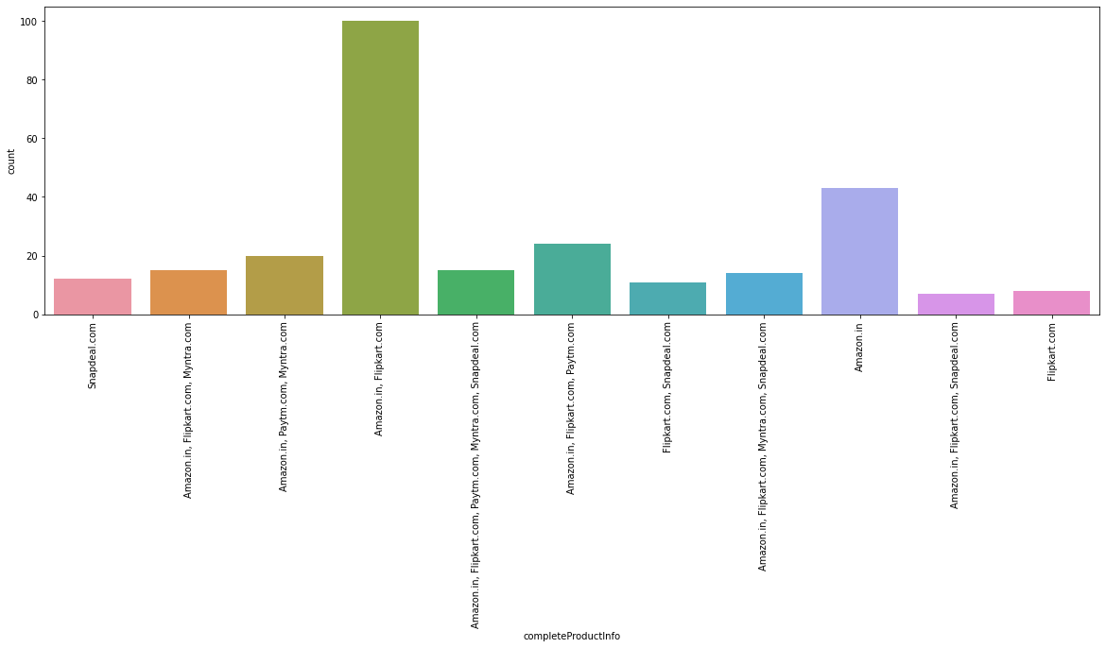
Complete Product Information
Highest count again goes to Amazon.com and Flipkart.com for Complete, relevant description information of products

Slide 22
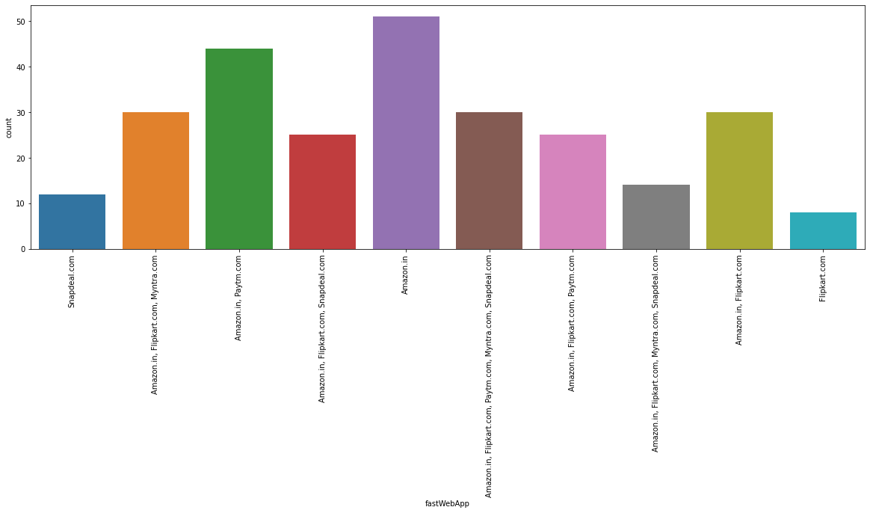
Fast Web Application
Amazon.com stands at the highest count for fast loading website speed /of website and application

Slide 23

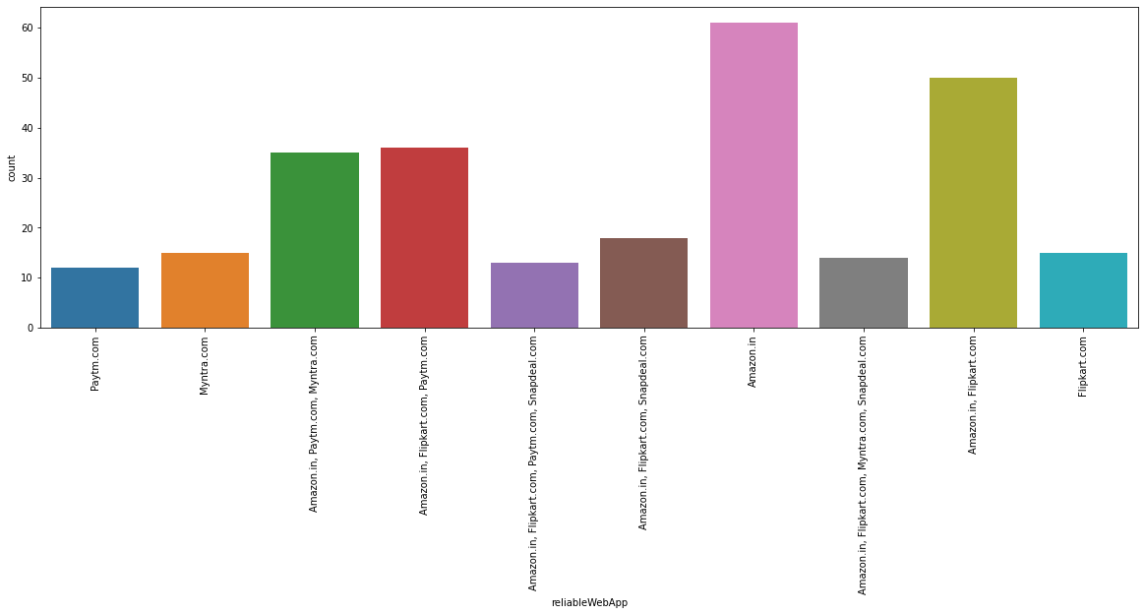
Reliability of the website or application:
Amazon.com is at highest next
Amazon.com and Flipkart.com once again

Slide 24
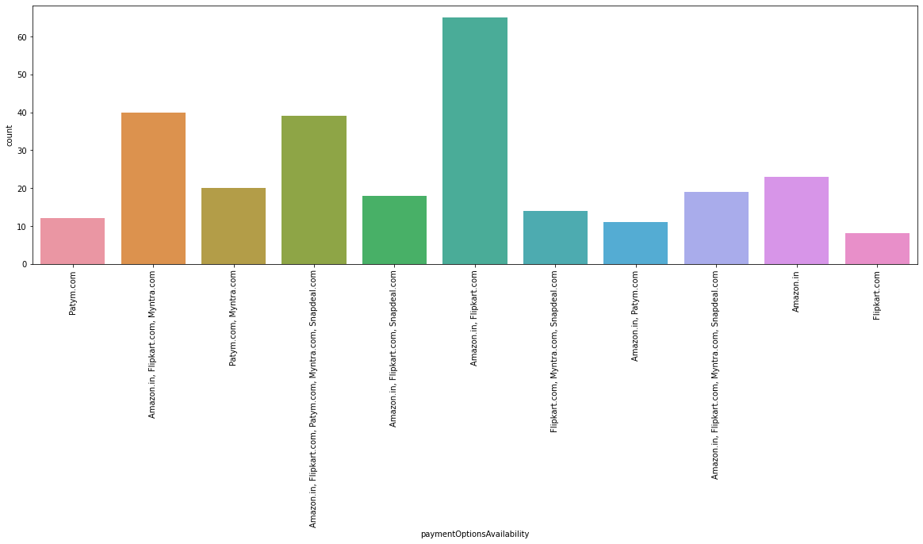
Payment Options Availability
Availability of several payment options: Here, Amazon and Flipkart, both are the favourites. Although a lot of people also tend to go towards Myntra

Slide 25
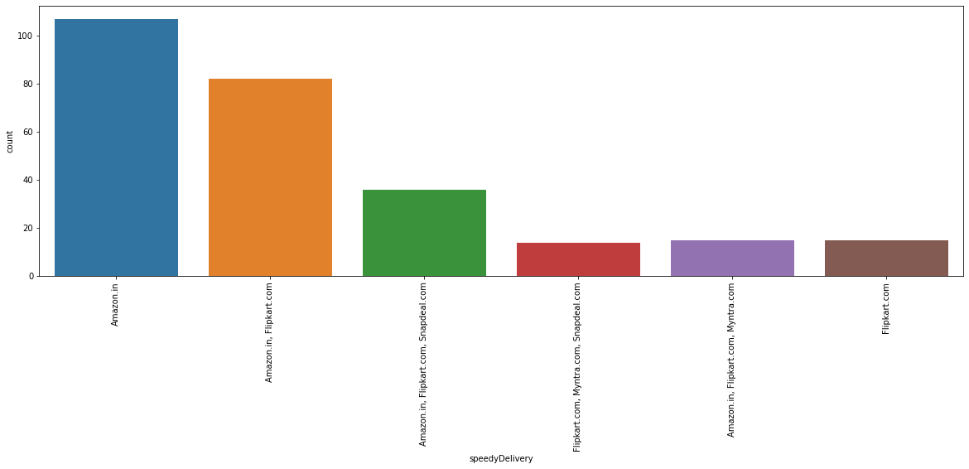
Speedy order delivery
Speedy order delivery: Amazon seems to take the lead in this category too, followed by Flipkart.

Slide 26
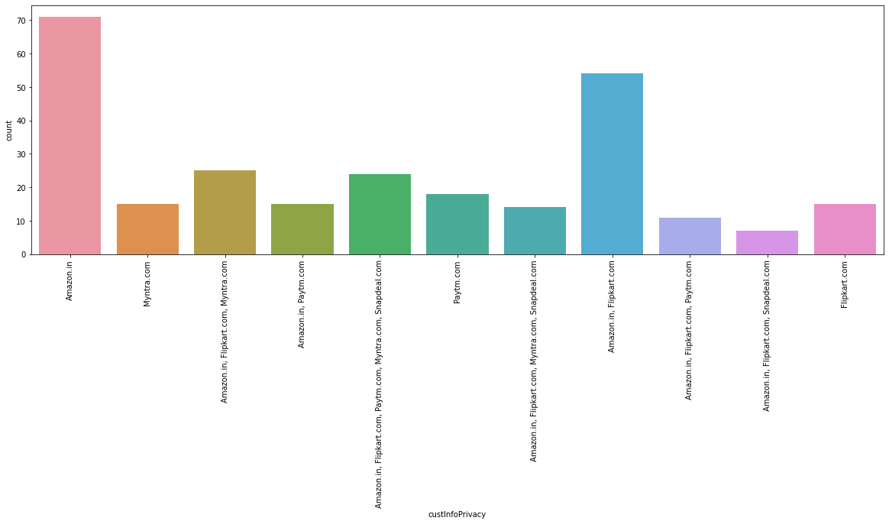
Privacy of customers’ information
Maximum count is for Amazon.in for having Privacy of customers’ information.

Slide 27
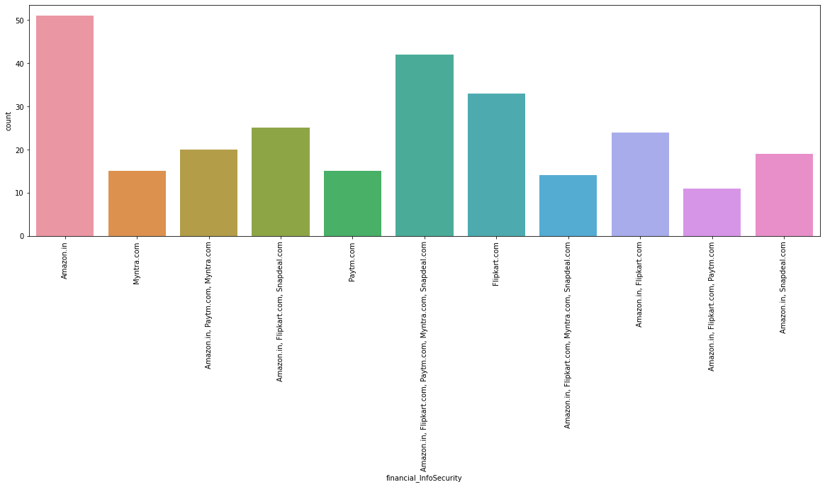
Security of customer financial information:
Not only Amazon but also Flipkart, Paytm.com, Myntra.com, Snapdeal.com are also trusted by a lot of people.

Slide 28
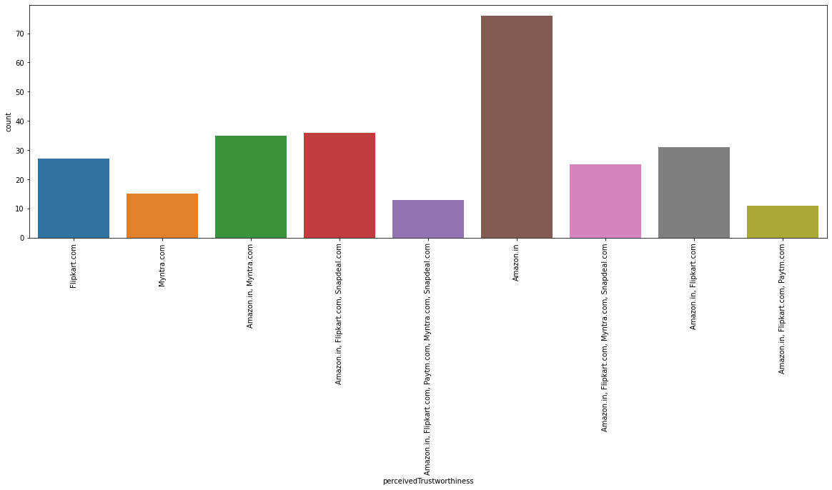
Perceived Trustworthiness
Perceived Trustworthiness: Amazon has gained the most trust worthy company by the participants and the next votes goes to Flipkart.com, Snapdeal.com and Myntra.com

Slide 29
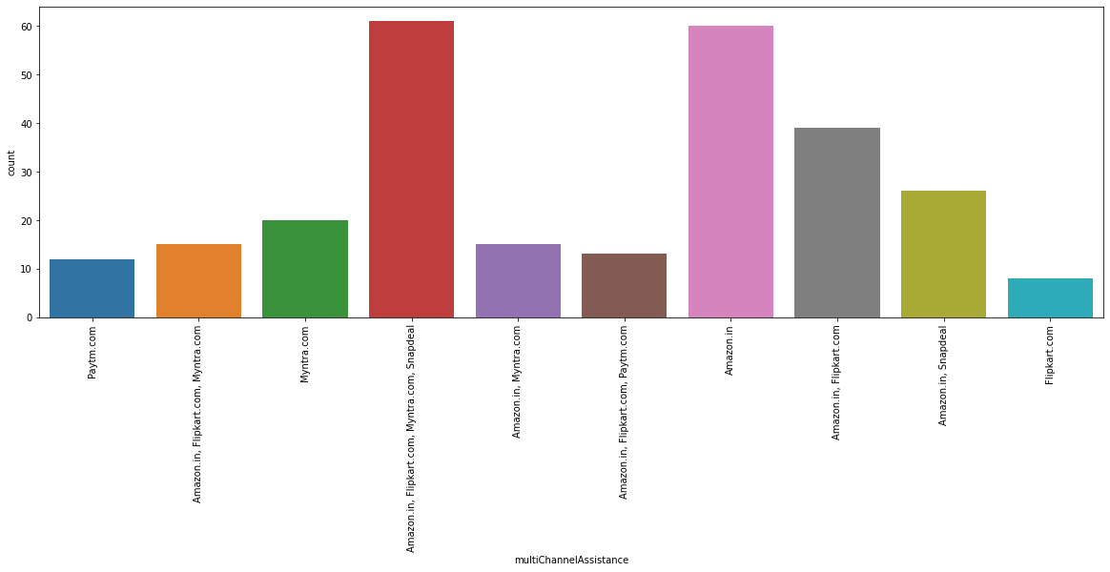
Multi Channel Assistance
MultiChannel Assistance: Amazon.in, Flipkart.com, Myntra.com, Snapdeal

Slide 30
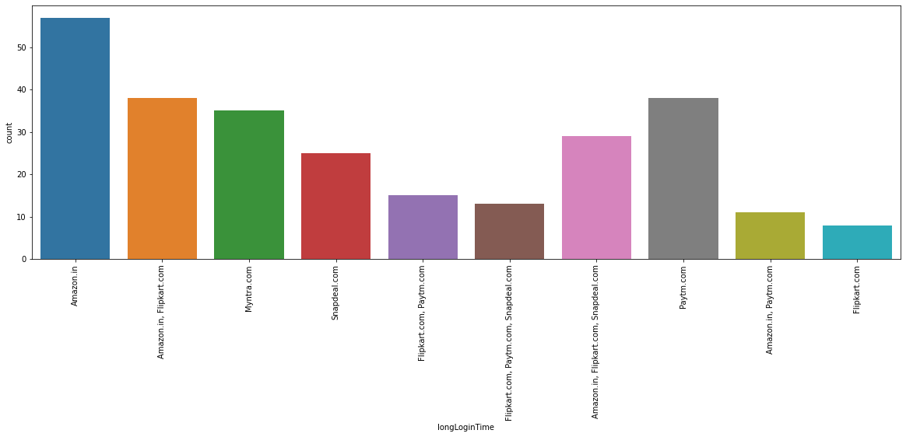
Long Login Time
Longer time to get logged in (promotion, sales period): "Amazon.in" and next "Paytm.com"

Slide 31
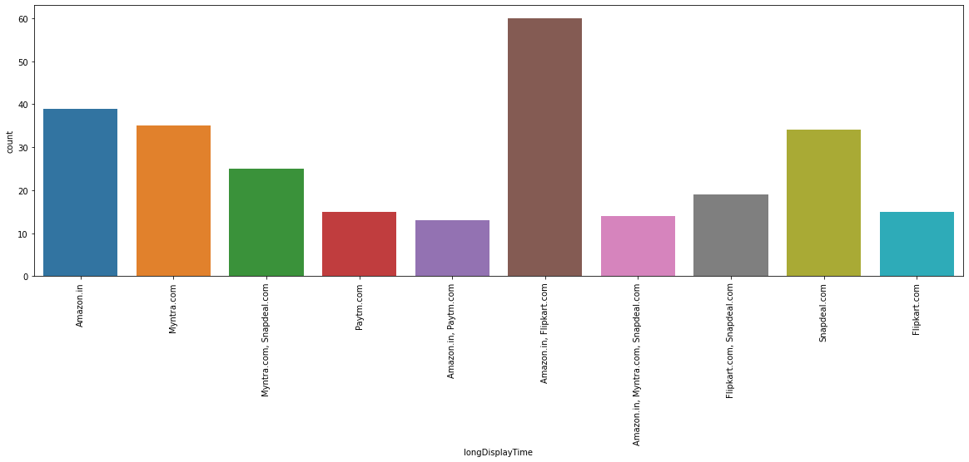
Long Display Time
Amazon.in, Flipkart.com for having Longer time in displaying graphics and photos (promotion, sales period).

Slide 32
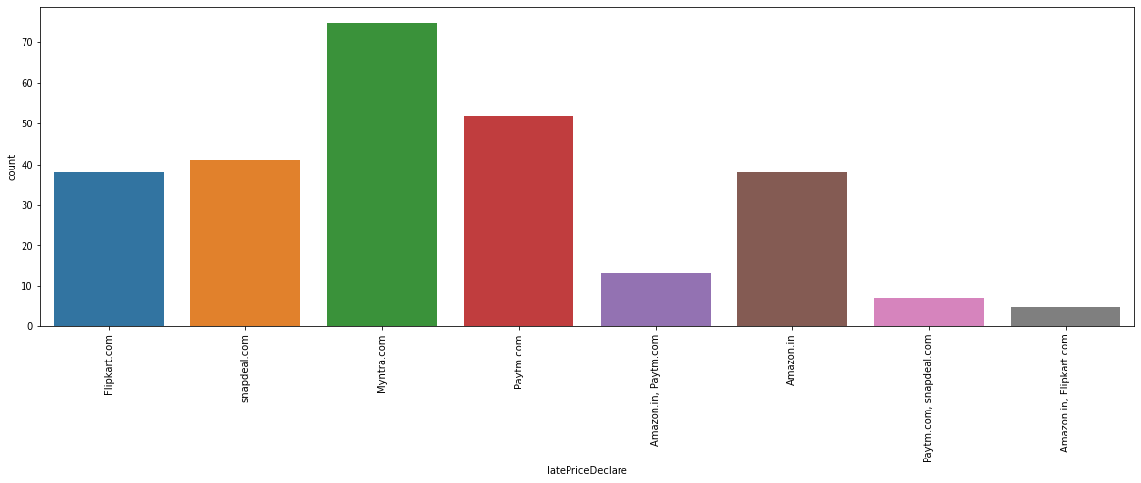
Late Declaration of Price
Late declaration of price: Myntra, Paytm, Snapdeal. These companies should work on this area to improve.

Slide 33
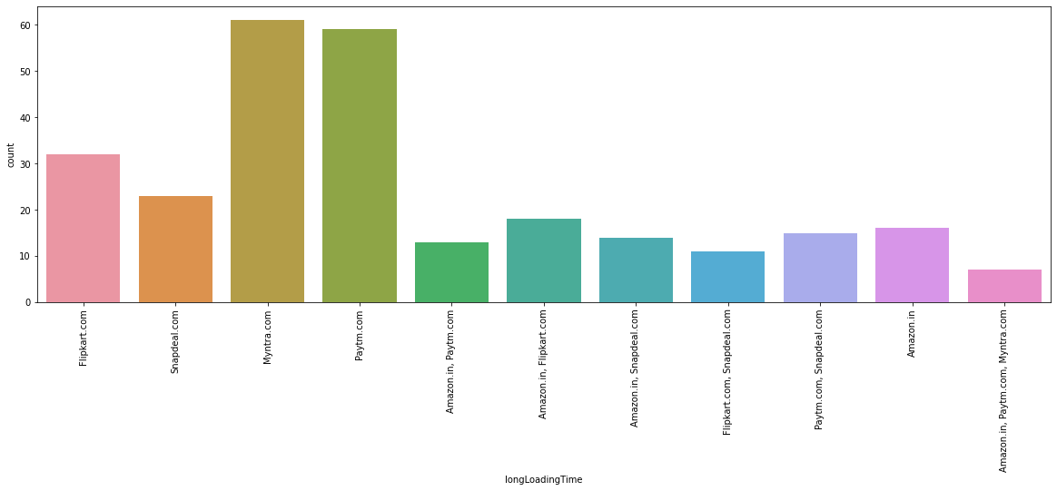
Longer Page Loading Time
Maximum count is for choosing Myntra.com for Longer page loading time (promotion, sales period).

Slide 34
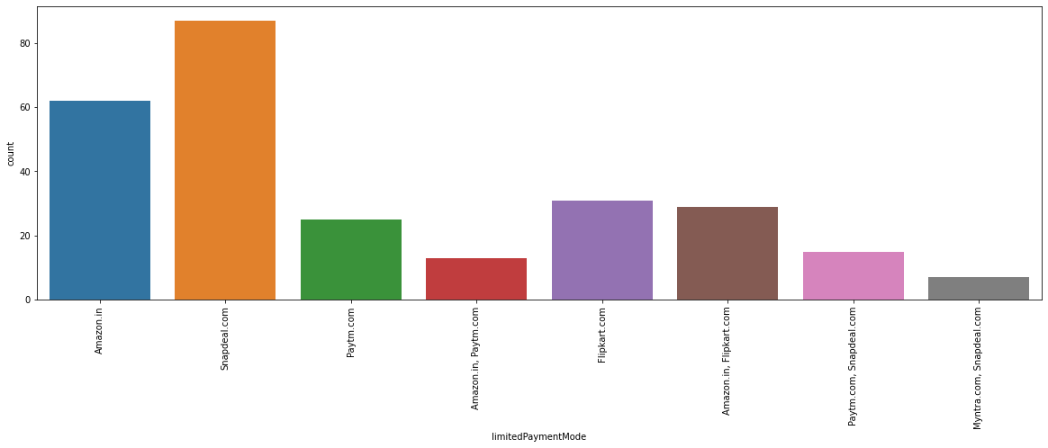
Limited mode of payment
Limited mode of payment on most products (promotion, sales period): Snapdeal is the most voted answer for this.

Slide 35
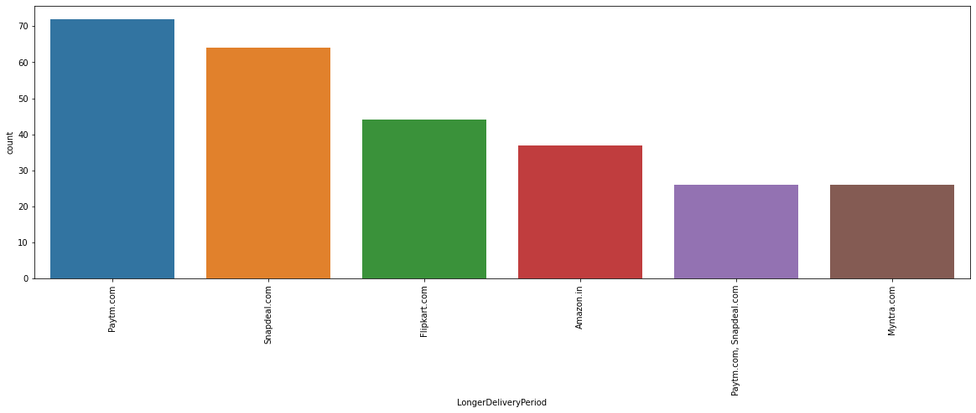
Longer Delivery Period
Maximum count is for Paytm.com for longer delivery period.

Slide 36
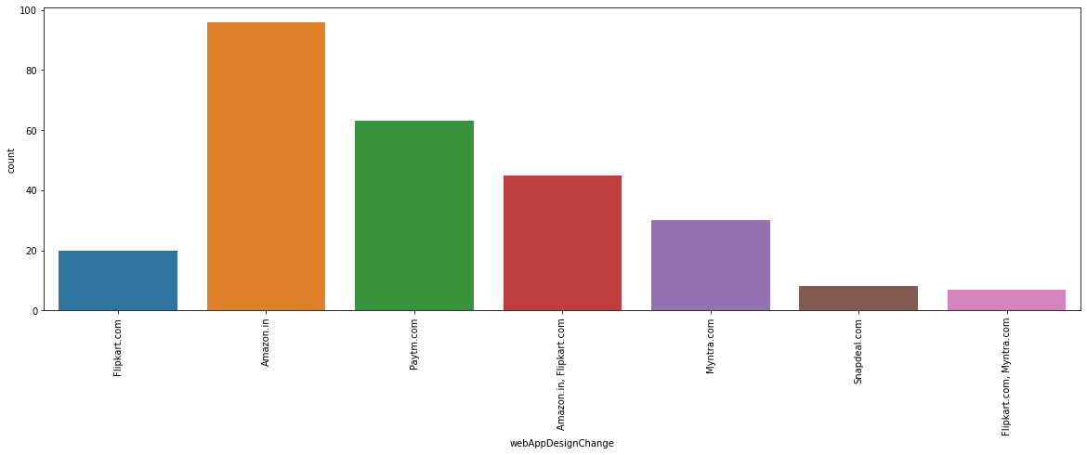
Change in website/Application design
Maximum count is for Amazon.in for having Change in website/Application design

Slide 37
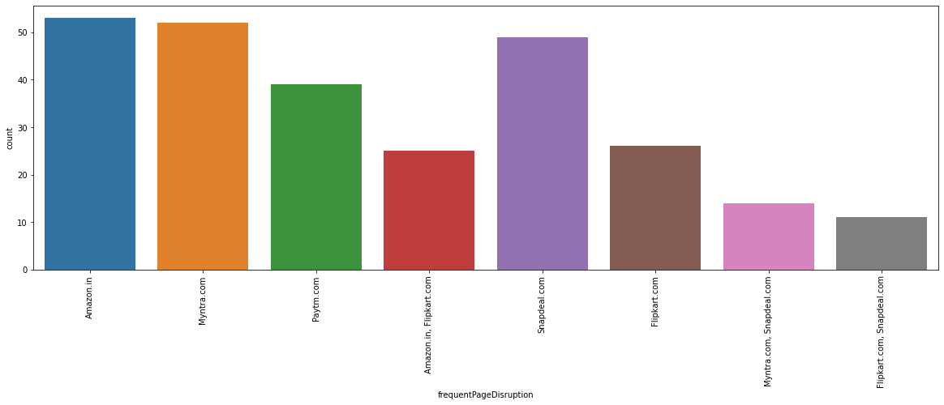
Frequent Page Disruption
Maximum count is for Amazon.in, Myntra.com and Snapdeal.com for having Frequent disruption when moving from one page to another.

Slide 38
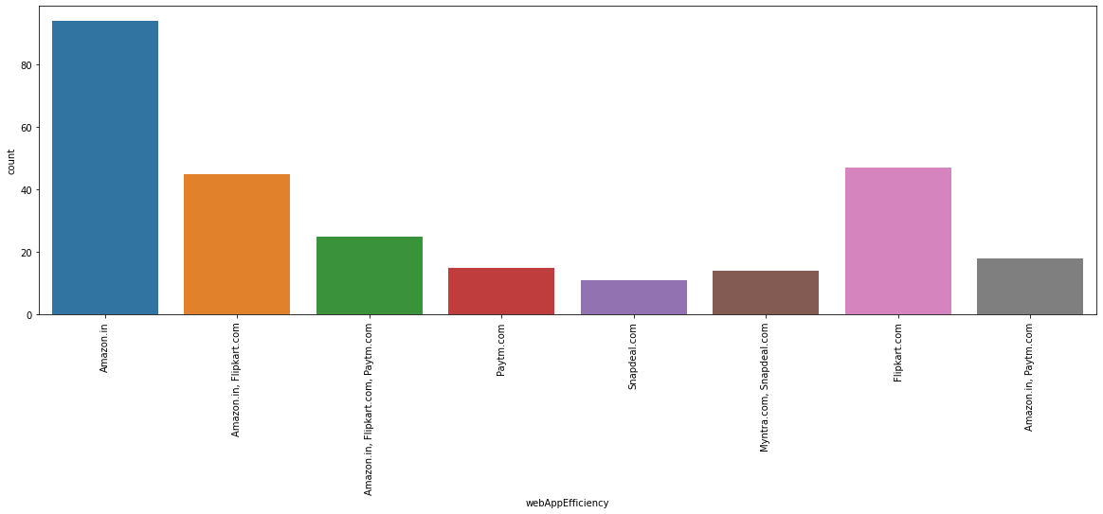
Web Application Efficiency
Maximum count is for Amazon.in for having Website is as efficient as before

Slide 39
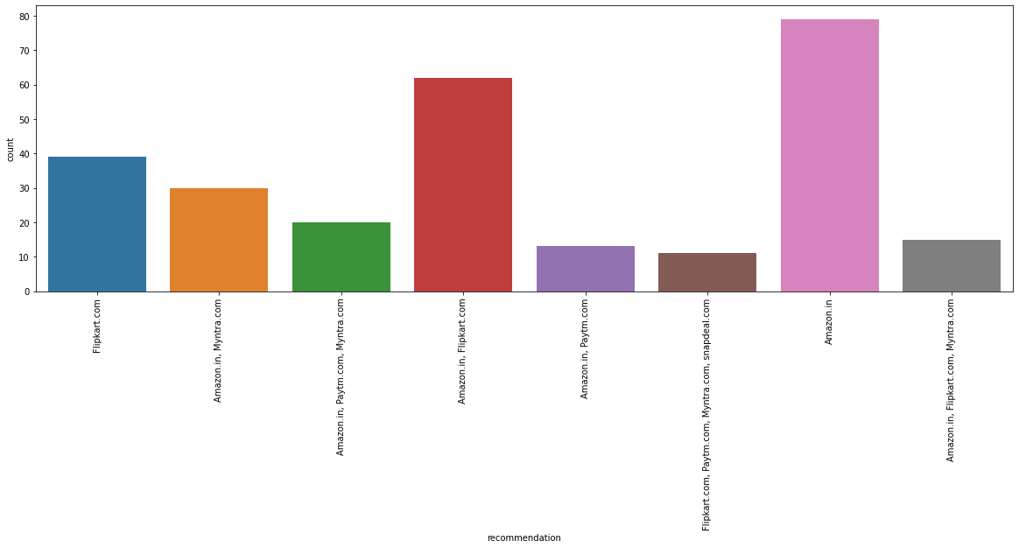
Maximum count is for Amazon.in for recommendation.

Slide 40
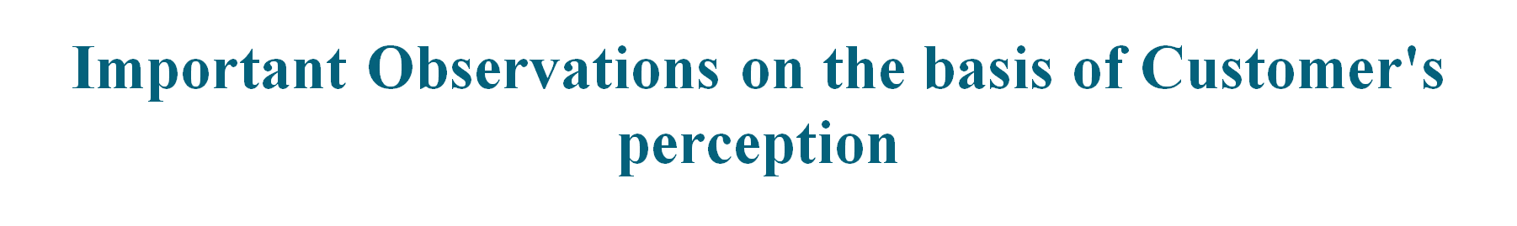
Majority customers believe that content on the website must be easy to read and understand.
70% people believe that complete information on listed seller and product is important for purchase decision.
90% people believe that all relevant information on listed products must be stated clearly.
For more than 90% people, ease of navigation of website, loading or processing speed as well as user friendly Interface of the website is important.
Other important parameters are - Convenient Payment Methods, privacy of customers, return and replacement policy.

Slide 41
Interpretation of the Results
Maximum number of customers satisfied and have high retention with Amazon.com and Flipkart.com.
Myntra.com and Snapdeal.com have high rate of attrition

Slide 42
Conclusion
Amazon.in is most recommended websites with attractive web-page layout, easy to use, relevant descriptive information, product offers, reliability of website, quickness to complete purchase, trust worthiness. But they have to focus on- Takes longer time to login, Late declaration or price during sales and promotion, frequent disruption when moving from one page to another, Limited mode of payment on most of products for improvement.
Flipkart.com is the 2nd most recommended website with fast loading page, security of financial information, trust worthiness, several payments modes, website is as efficient as before. But for improvement have to focus on: Takes longer time in displaying graphics, late declaration of price during sales and promotion.

Slide 43
Few ways to improve customer retention can be as follows:
User-friendly websites
Improve return & refund policy
Privacy Policy
Displaying quality Information
Responsiveness

Slide 44
Thank You

